Slide 1
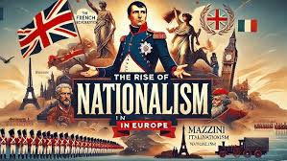
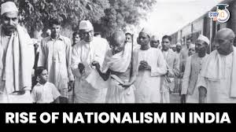
CBSE Class X | History
NATIONALISM
in Europe & India
One Idea. Two Continents. One Revolution.

Slide 2
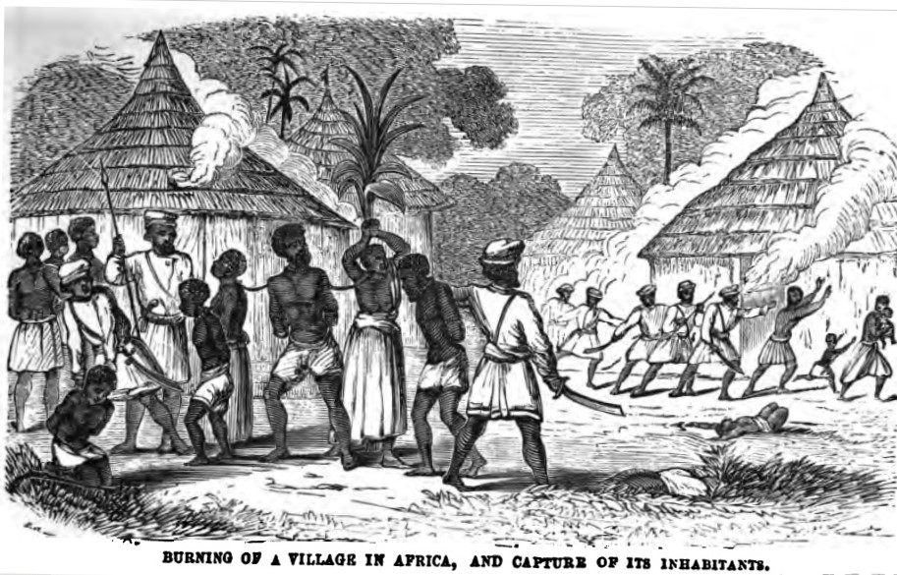
“
Imagine you have no country. No language they let you speak. No history they let you read. No name they call you by.
🙋 ASK THE CLASS
If you couldn't speak Tamil / your mother tongue in school — how would you feel?
This was the story of millions across Europe and India in the 1800s.
]

Slide 3
What Is Nationalism?
The belief that people who share a common language, culture, history, or territory should form their own nation-state.
🗣
🏛
🌍
Shared
Language
Shared
History
Shared
Territory

Slide 4
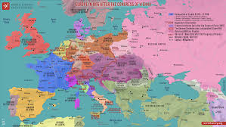
PART 1
Nationalism in EUROPE
1789
1848
1871
French Revolution
Springtime of Nations
Unification of Germany & Italy
Liberty, Equality, Fraternity spreads nationalist ideas across Europe
Revolutions erupt in France, Germany, Italy, Austria-Hungary
Bismarck unites German states; Garibaldi unites Italy

Slide 5
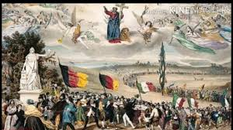
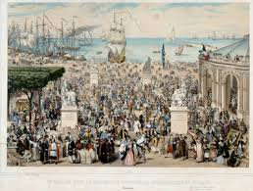
The Dream of a United Europe
Frederic Sorrieu's Vision (1848)
Sorrieu, a French artist, painted people of all nations marching together, carrying their flags — the first visual dream of a 'United States of the World'.
The Zollverein (1834)
A customs union formed by Prussia that united 39 German states economically — paving the way for political unification.
🙋 Quick Think: What would happen if Indian states each had different currencies & customs?

Slide 6
PART 2
Nationalism in INDIA
⚔ 1857 Revolt
📰 Print Culture
🤝 Indian National Congress (1885)
First war of independence — sepoys and nawabs unite against the British East India Company
Newspapers in vernacular languages spread nationalist ideas to common people across India
First organized political platform — bringing educated Indians together to demand rights
[ IMAGE: A photograph of 1857 revolt / INC first session at Bombay ]

Slide 7
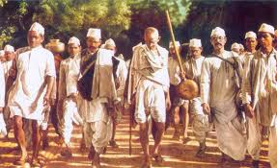
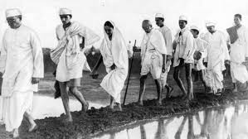
Gandhi & the Birth of Mass Nationalism
“Be the change you wish to see in the world.” — M.K. Gandhi
1919
Non-Cooperation Movement
1930
Civil Disobedience & Dandi March
1942
Quit India Movement
🎯 Real Example: Dandi March (1930) — Gandhi walked 241 miles to make salt, defying British law.

Slide 8
⚡ QUICK ACTIVITY (3 minutes)
COMPARE & CONNECT — Work with your neighbor!
🇪🇺 European Nationalism
🇮🇳 Indian Nationalism
→ Led by educated middle class
→ Triggered by French Revolution
→ Bismarck used 'Blood & Iron'
→ Relied on art, music & literature
→ Led by Gandhi & masses
→ Triggered by colonial exploitation
→ Used non-violence as a weapon
→ Used Swadeshi & civil disobedience
VS
🤔 What is ONE similarity you notice? Share with the class!

Slide 9
🧠 QUIZ TIME!
Raise your hand for the correct answer!
Q1. Who said 'When France sneezes, the rest of Europe catches cold'?
A) Napoleon
C) Bismarck
B) Metternich ✓
D) Garibaldi
Q2. The Dandi March (1930) was to protest against...
A) Partition of Bengal
C) Salt Tax ✓
B) Rowlatt Act
D) Simon Commission
Q3. Which treaty redrew Europe's map after Napoleon's defeat?
A) Treaty of Vienna ✓
C) Treaty of Versailles
B) Treaty of Paris
D) Treaty of Westphalia

Slide 10
Key Takeaways
🌍
Nationalism is the idea that people with shared culture/history should form their own nation.
⚡
In Europe, the French Revolution (1789) ignited the first wave of modern nationalism.
📖
Romanticist writers, artists, and musicians helped build a sense of national identity.
🕊
In India, nationalism took the form of non-violent resistance under Mahatma Gandhi.
🔗
Both movements show that ordinary people — not just leaders — make history.

Slide 11
Remember This Always
“Nations are not born. They are built — by ordinary people who dared to dream of something bigger than themselves.”
Final Reflection Question for Homework:
"In what ways do you think nationalism still shapes the world today — and is it always a positive force?"
CBSE History • The Rise of Nationalism in Europe (Ch.1) • Nationalism in India (Ch.3)

